Slide 1


DEPARTMENT OF COMPUTER SCIENCE AND ENGINEERING
20CS8504 & PROJECT WORK
END SEMESTER PRACTICAL EXAMINATION- APRIL / MAY – 2026
Batch No.: 13
Date: 30/03/2026
Session: AN

Slide 2
A Secure And Privacy-Preserving Framework for Cross-Domain Data Sharing Using ML
Team Members:
811722104028 - Devadharshini S
811722104037 - Elakkiya A
811722104042 - Gayathri M
Guide Name:
Mrs.A.Dhivya Bharathi, M.E.,(Ph,D.,)

Slide 3
OBJECTIVE OF THE PROJECT
To develop a secure encrypted messaging system for safe communication.
To implement user authentication through registration and login.
To provide passkey-based decryption for accessing messages.
To implement message request and acceptance to avoid spam communication.
To integrate Machine Learning for detecting suspicious activities.

Slide 4
INTRODUCTION
In today’s digital world, online communication has become an essential part of daily life.
Messaging platforms are widely used for personal, educational, and professional communication.
However, many messaging systems face security risks such as data breaches and unauthorized access.
Sensitive information shared through messages can be intercepted or misused by attackers.
There is a need for a secure communication system that protects user privacy and data.

Slide 5
LITERATURE SURVEY
TITLE OF PAPER | AUTHOR(S) | PAPER GIST | TECHNOLOGY USED
Privacy Passport: Privacy-Preserving Cross-Domain Data Sharing | Xue Chen, Cheng Wang, Qing Yang, Teng Hu, Changjun Jiang | IEEE Transactions on Information Forensics and Security, 2025 | Attribute-Based Access Control ,Cryptographic policy translation
Federated Learning for Cross-Domain Data Privacy: A Distributed Approach to Secure Collaboration | Yiwei Zhang, Jie Liu, Jiawei Wang, Lu Dai, Fan Guo, Guohui Cai | arXiv, 2025 | Federated Learning (FL) ,Secure aggregation protocols ,Local model training
PPGenCDR: A Stable and Robust Framework for Privacy-Preserving Cross-Domain Recommendation | Xinting Liao, Weiming Liu, Xiaolin Zheng, Binhui Yao, Chaochao Chen | arXiv, 2023 | Generative Adversarial Networks , Differential Privacy ,Cross-domain representation learning.
A Privacy-Preserving Model based on Differential Approach for Sensitive Data in Cloud Environment | Ashutosh Kumar Singh & Rishabh Gupta | arXiv, 2022 | Differential Privacy (Laplace & Gaussian noise mechanisms).
Federated Learning for Privacy-Preserving AI: Revolutionizing Data Sharing Across Industries | Sharathchandra Patil , K Sai Geethanjali , Nidhi Umashankar | AAMAS 2019 | Secure Multi-Party Computation, Federated optimization, Distributed Constraint.

Slide 6
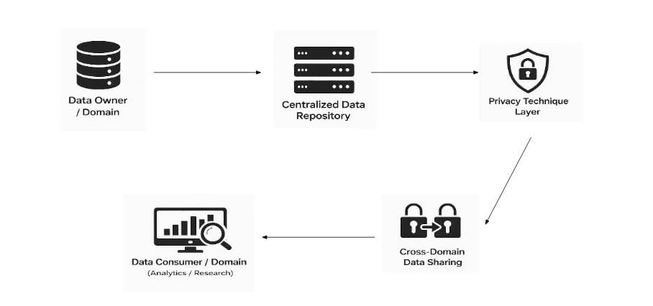
EXISTING SYSTEM ARCHITECTURE

Slide 7
PROBLEM IDENTIFIED
Messages may be stored directly in databases
Unauthorized users may intercept messages
There is no passkey protection
Spam and unwanted messages are common
No intelligent monitoring for suspicious activities

Slide 8
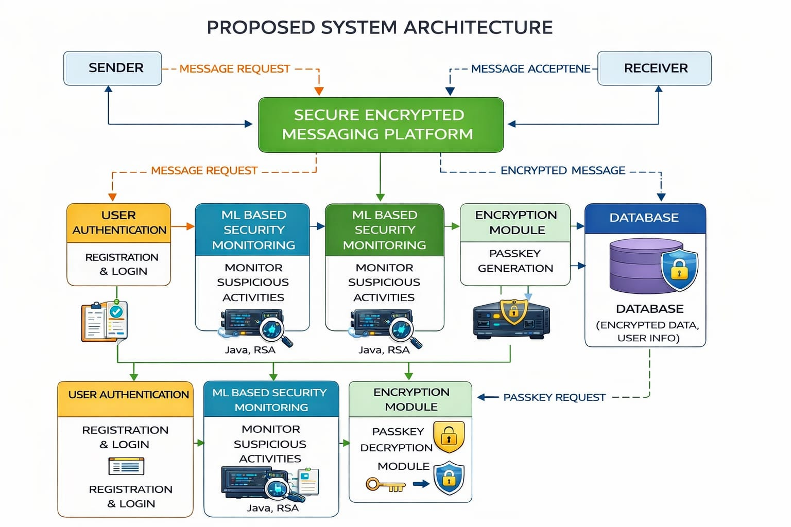
PROPOSED SYSTEM ARCHITECTURE

Slide 9
SOFTWARE AND HARDWARE REQUIREMENTS
HARDWARE
1. Processor : Intel Core i3
2. RAM : 4 GB or above
3. Hard Disk : 500 GB
SOFTWARE
1. Operating System : Windows 10
2. Programming Language : Python
3. Frontend : HTML, CSS, JavaScript
4. Backend : Flask / Django
5. Database : MySQL
6. ML Library : Scikit-learn

Slide 10
MODULES
1. User Registration and Login Module
2. Message Request and Acceptance Module
3. Message Encryption Module
4. Passkey Generation and Decryption Module
5. Database and Secret Key Management Module

Slide 11
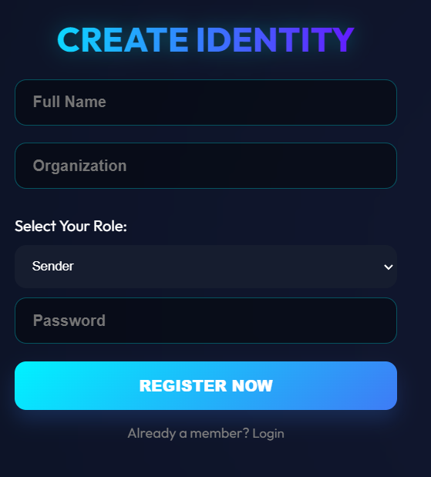
USER REGISTRATION AND LOGIN MODULE
This module is responsible for user authentication and access control in the system.
New users must first register by providing details such as username, email ID, and password. The system stores these details securely in the database.
After registration, users can log in using their credentials. This module ensures that unauthorized users cannot enter the platform.
Screenshot of Module - 1

Slide 12
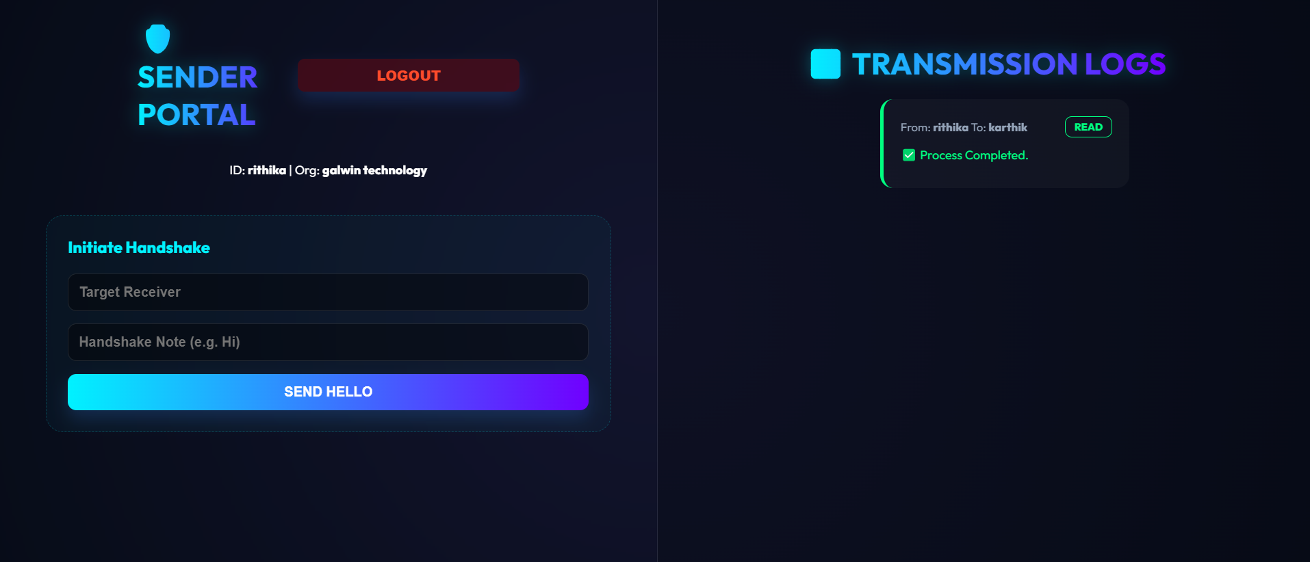
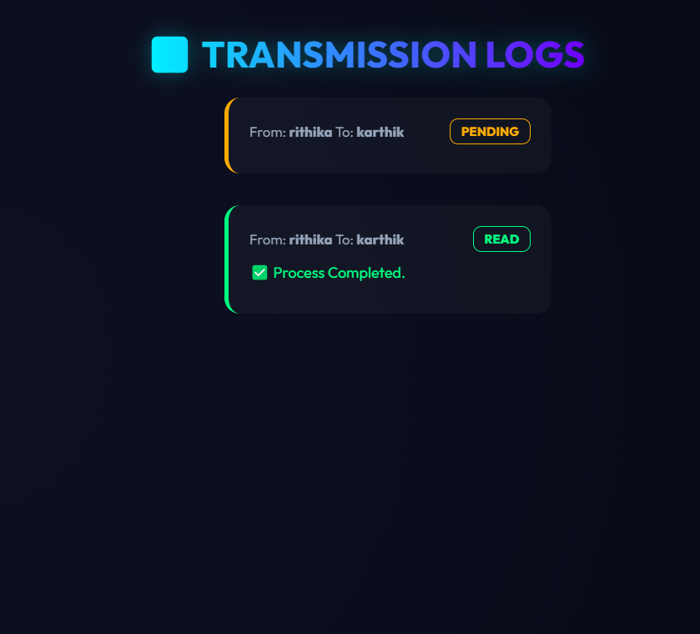
MESSAGE REQUEST AND ACCEPTANCE MODULE
In this module, the sender sends a message request to the receiver before the actual message is delivered.
The receiver will receive a notification about the request. The receiver must accept the request to start communication.
If the receiver does not accept the request, the message will not be delivered.
Screenshot of Module - 2

Slide 13
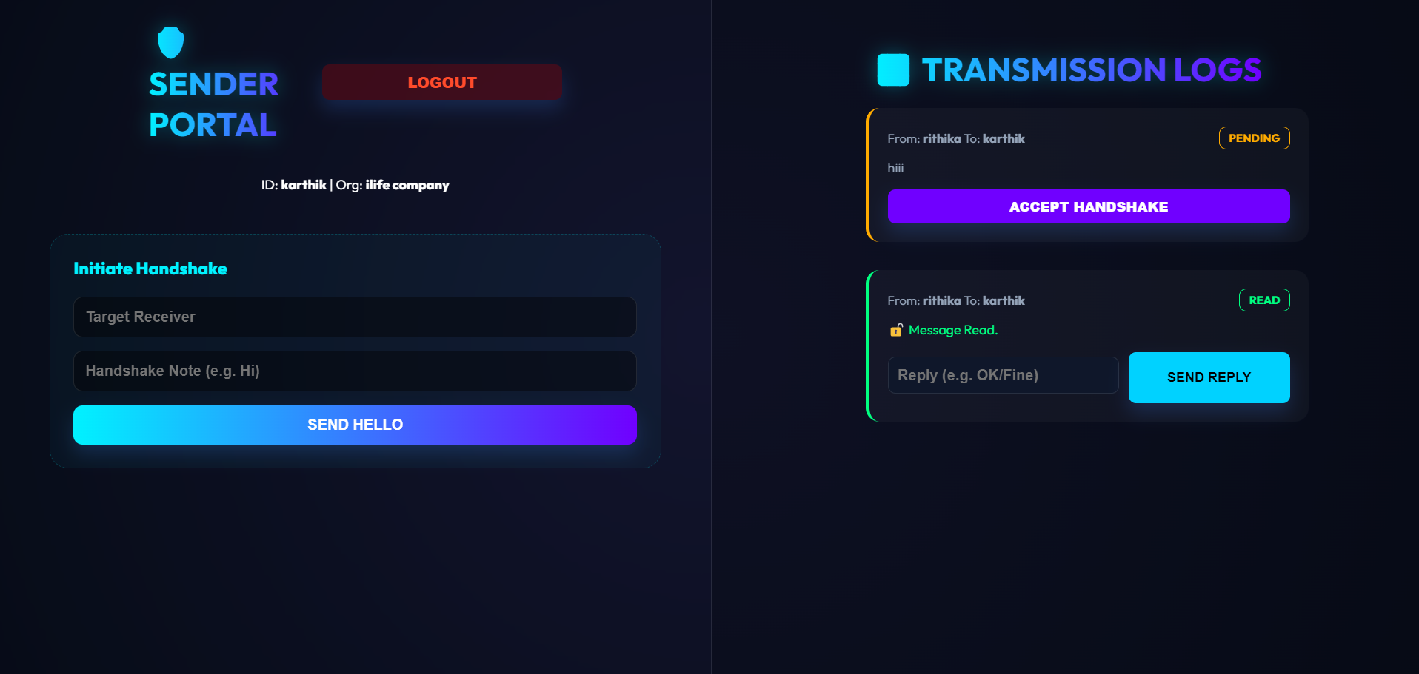
MESSAGE ENCRYPTION MODULE
The message encryption module ensures that messages are converted into a secure encrypted format before transmission.
When the sender sends a message, the system uses an encryption algorithm and a secret key to transform the original message into an encoded or unreadable form.
This encrypted message is then sent to the receiver.
Screenshot of Module - 3

Slide 14
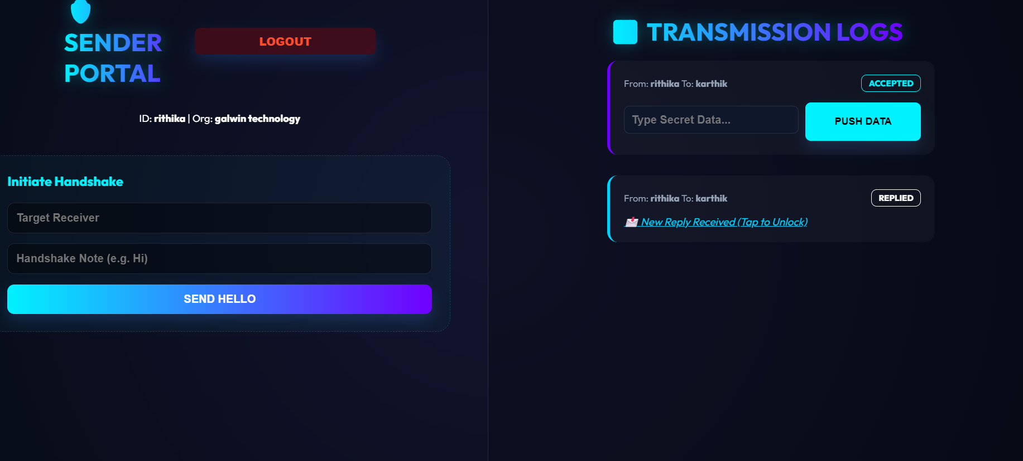
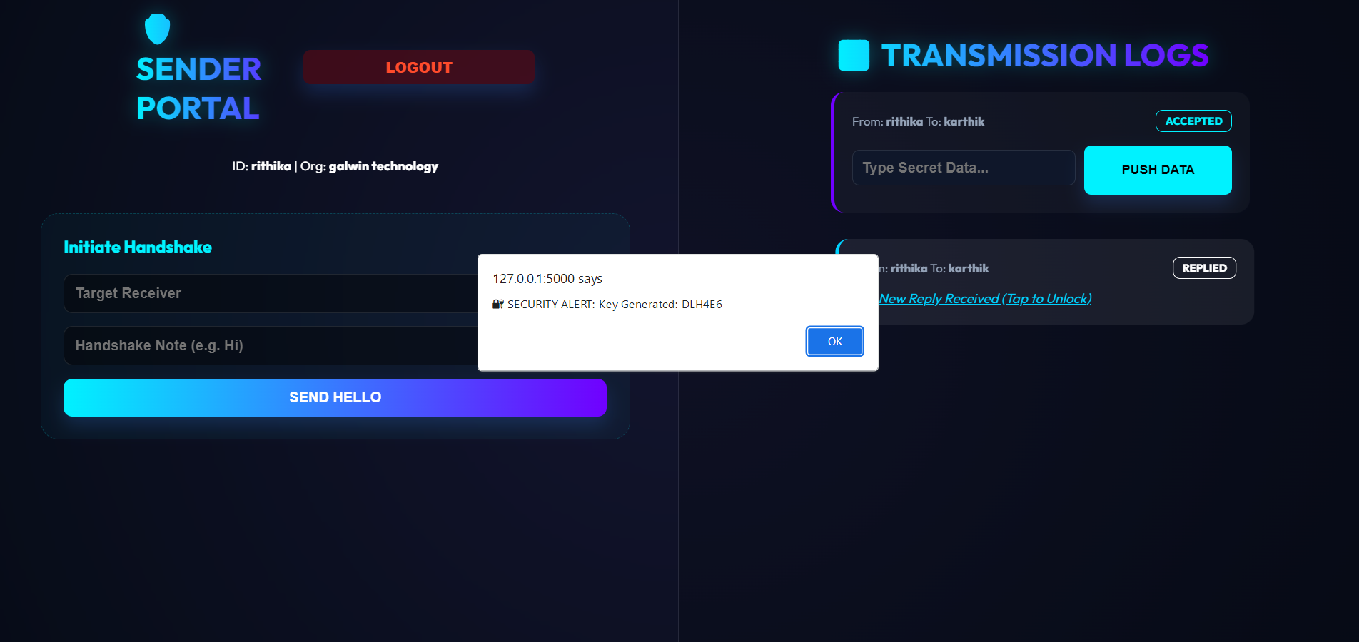
PASSKEY GENERATION AND DECRYPTION MODULE
When the receiver receives the encrypted message, it will appear as a different or coded message.
To read the original message, the receiver must click on the encrypted message. The system will then generate a unique passkey.
After entering the correct passkey, the system decrypts the message and displays the original content.
Screenshot of Module - 4

Slide 15
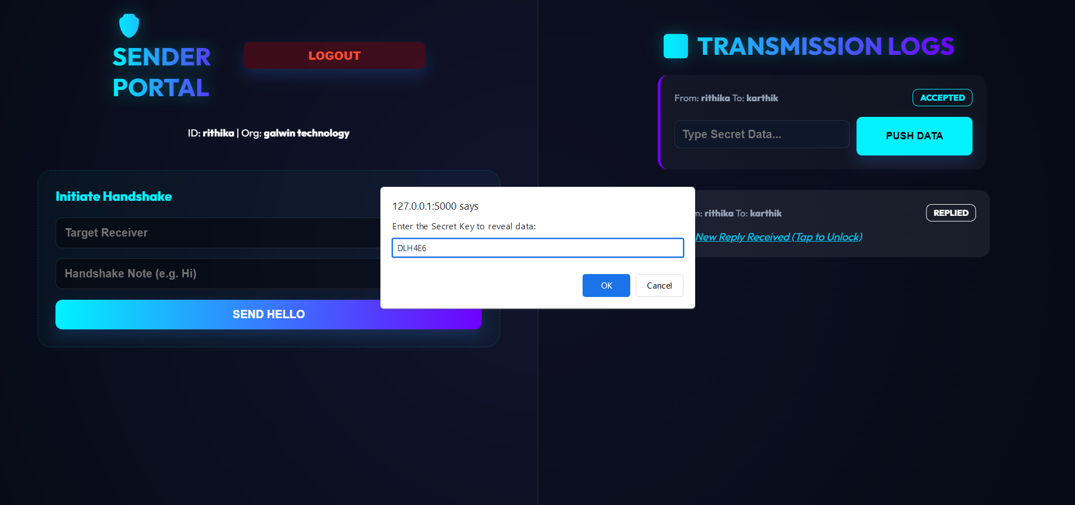
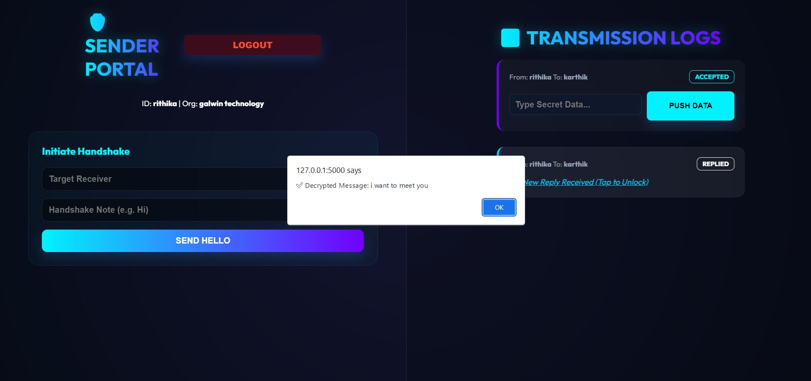
DATABASE AND SECRET KEY MANAGEMENT MODULE
This module handles the storage and management of system data. User details, encrypted messages, and communication records are stored securely in a database.
Proper key management ensures that only authorized processes can access the encryption keys, thereby protecting the confidentiality and integrity of the stored data.
Screenshot of Module - 5

Slide 16
CONCLUSION
The project develops a secure encrypted messaging system for safe communication. It provides user authentication through registration and login. Messages are encrypted before transmission to ensure data privacy. The passkey-based decryption adds an extra layer of security.
The system helps to prevent unauthorized access to messages. Machine Learning is used to detect suspicious activities and spam messages. The system improves data confidentiality, integrity, and reliability. Overall, the proposed system provides a secure and intelligent messaging platform.

Slide 17
FUTURE ENHANCEMENTS
Develop a mobile application version (Android/iOS) for easier access. Add multi-factor authentication (OTP or biometric) for better user verification.
Add real-time notifications and message status indicators. Improve the user interface for better user experience.

